Slide 1


Slide 2
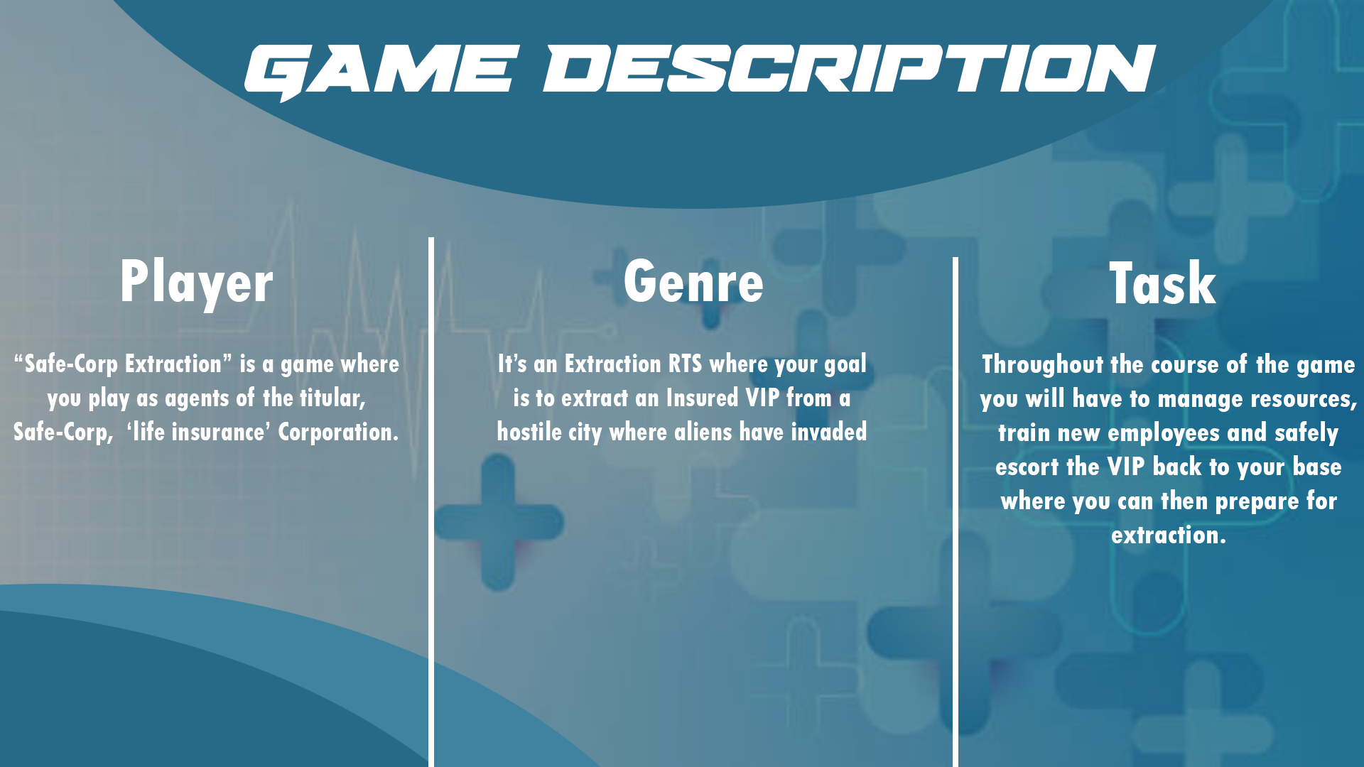

Slide 3
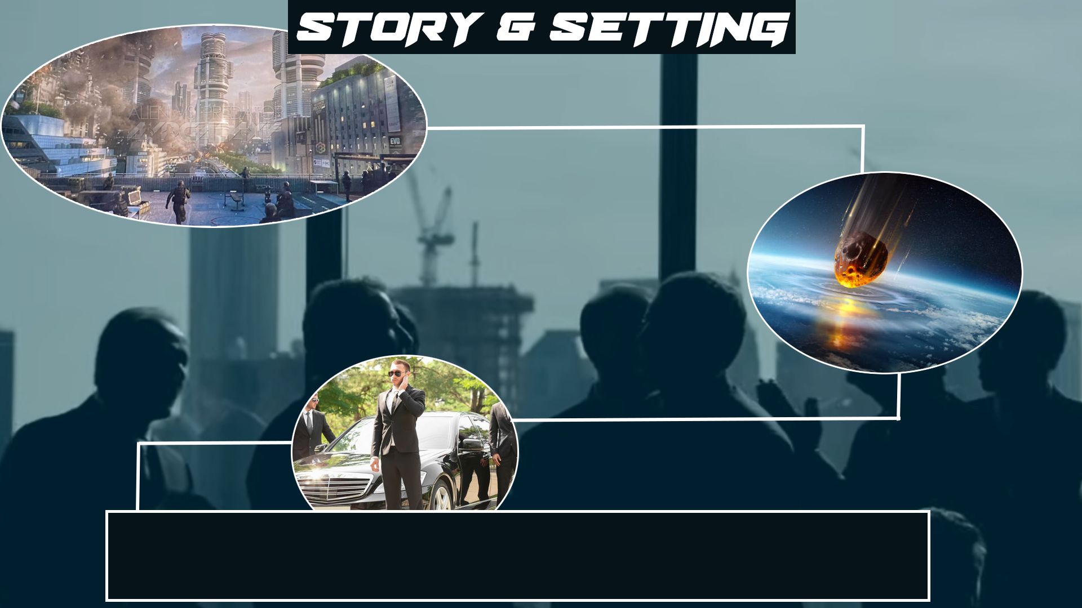
Story and Setting
https://youtu.be/-xu2lgyGnj0

Slide 4
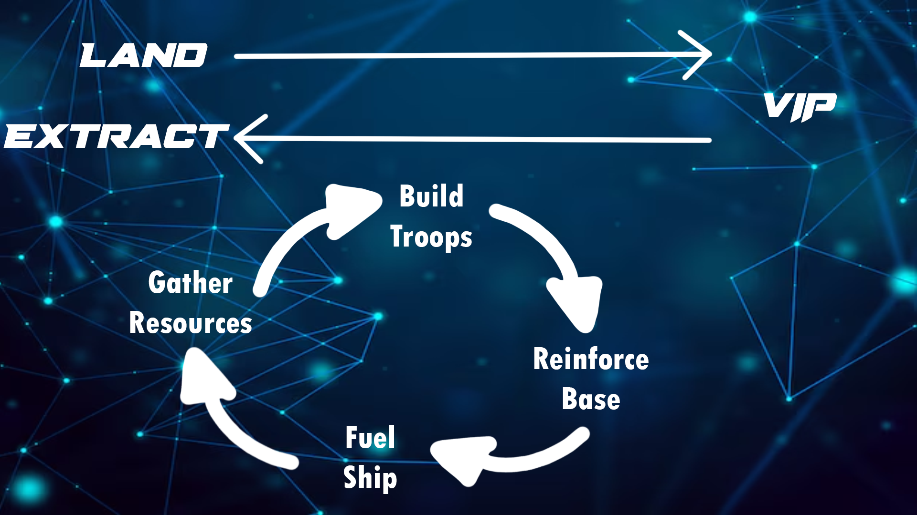
Core Gameplay Loop

Slide 5
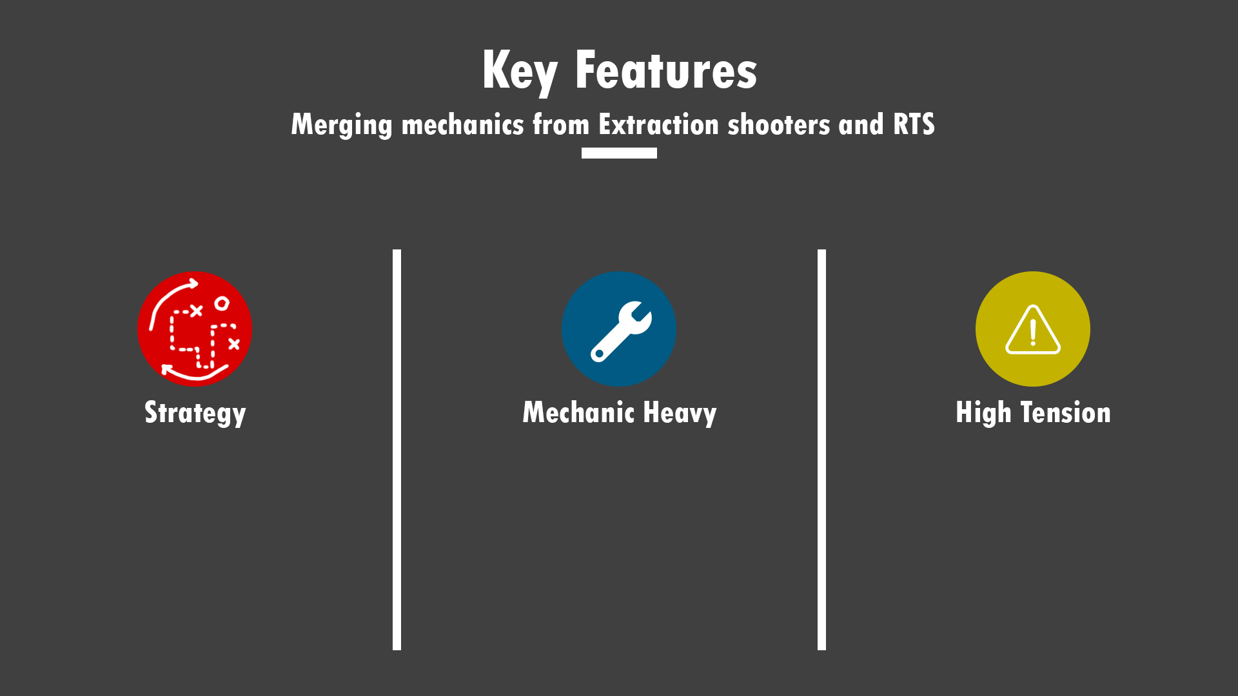
Key Features

Slide 6
Meet The Team
Team Lead And AI: Joe
QA and Balance: Seamus
Art Lead and 3D modeler: David
Systems Designer: Max
UI And UX Design: Josh
Supporting Artist: Kira

Slide 7
Target Audience
Satire Enjoyers
RTS Players
Casual strategy game enjoyers.
PC Steam

Slide 8
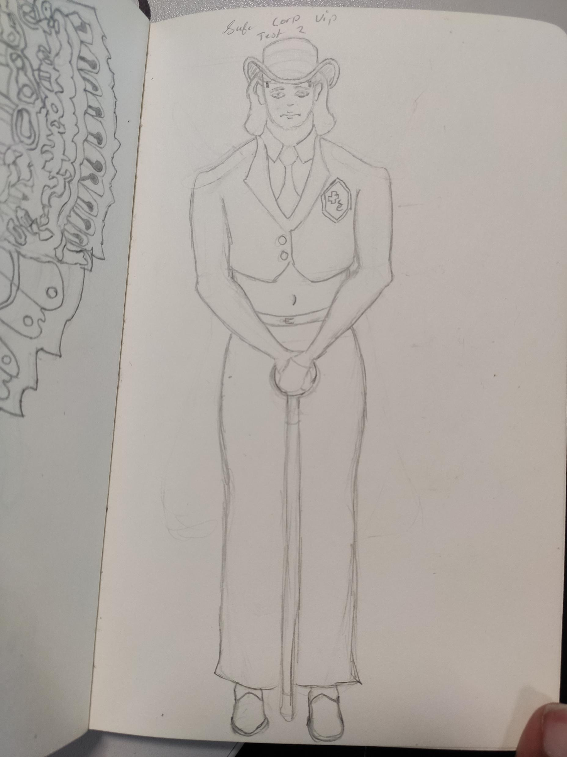
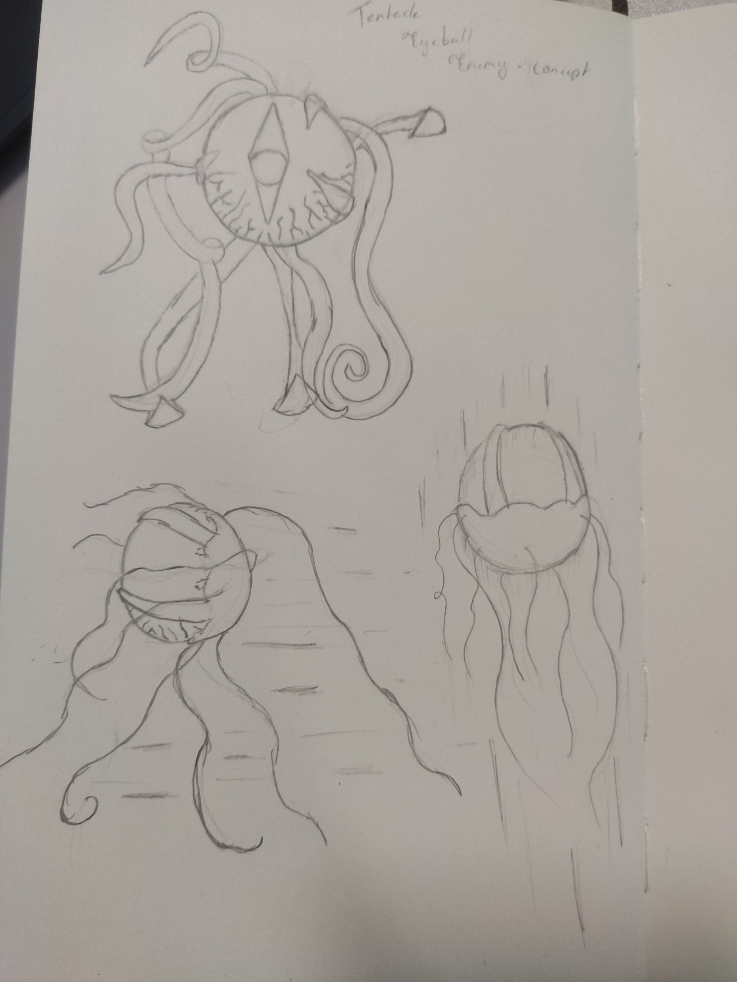
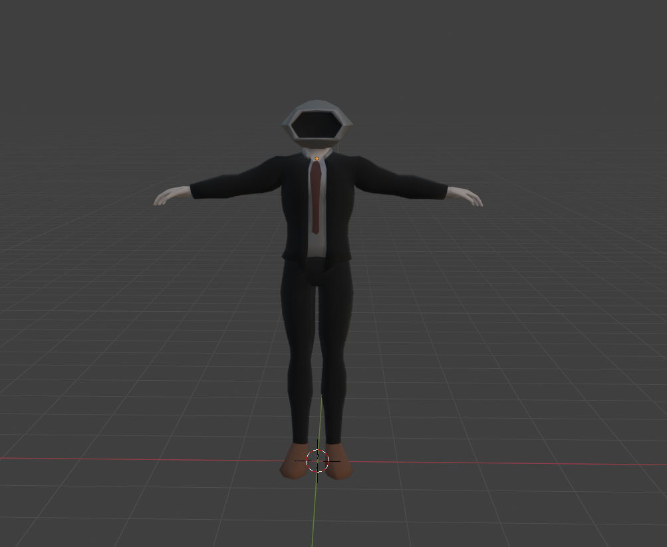
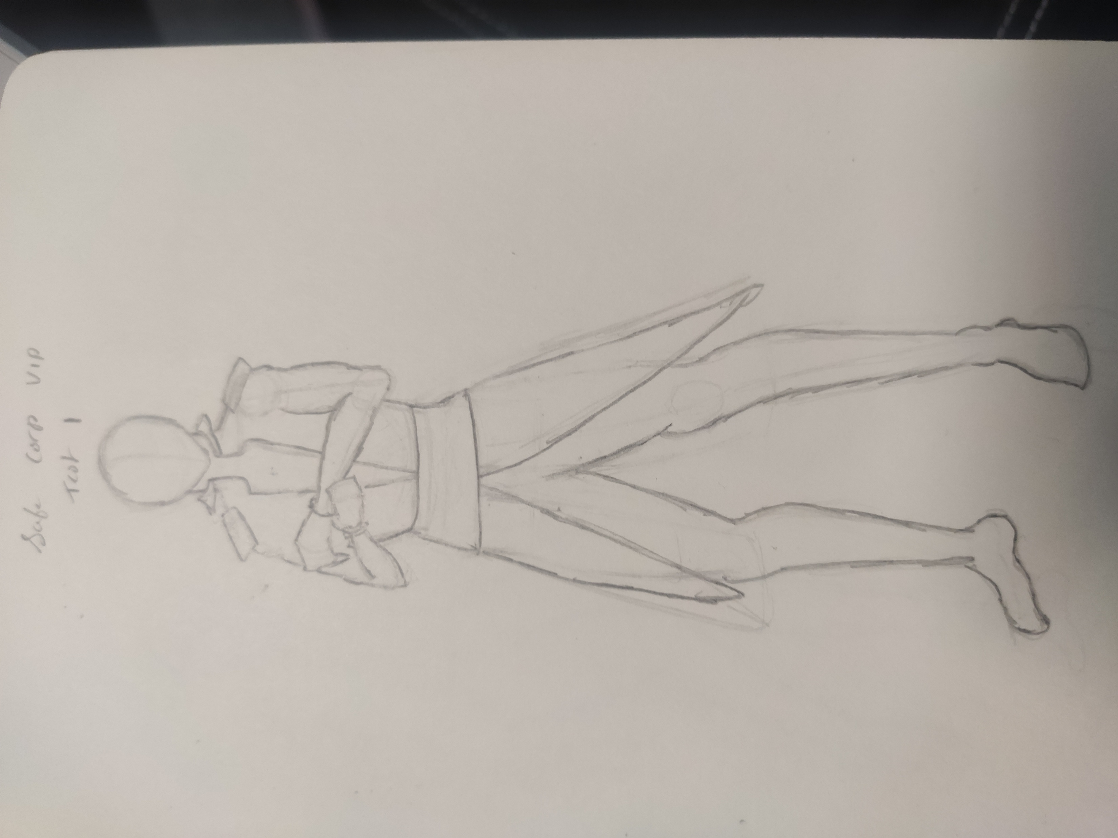
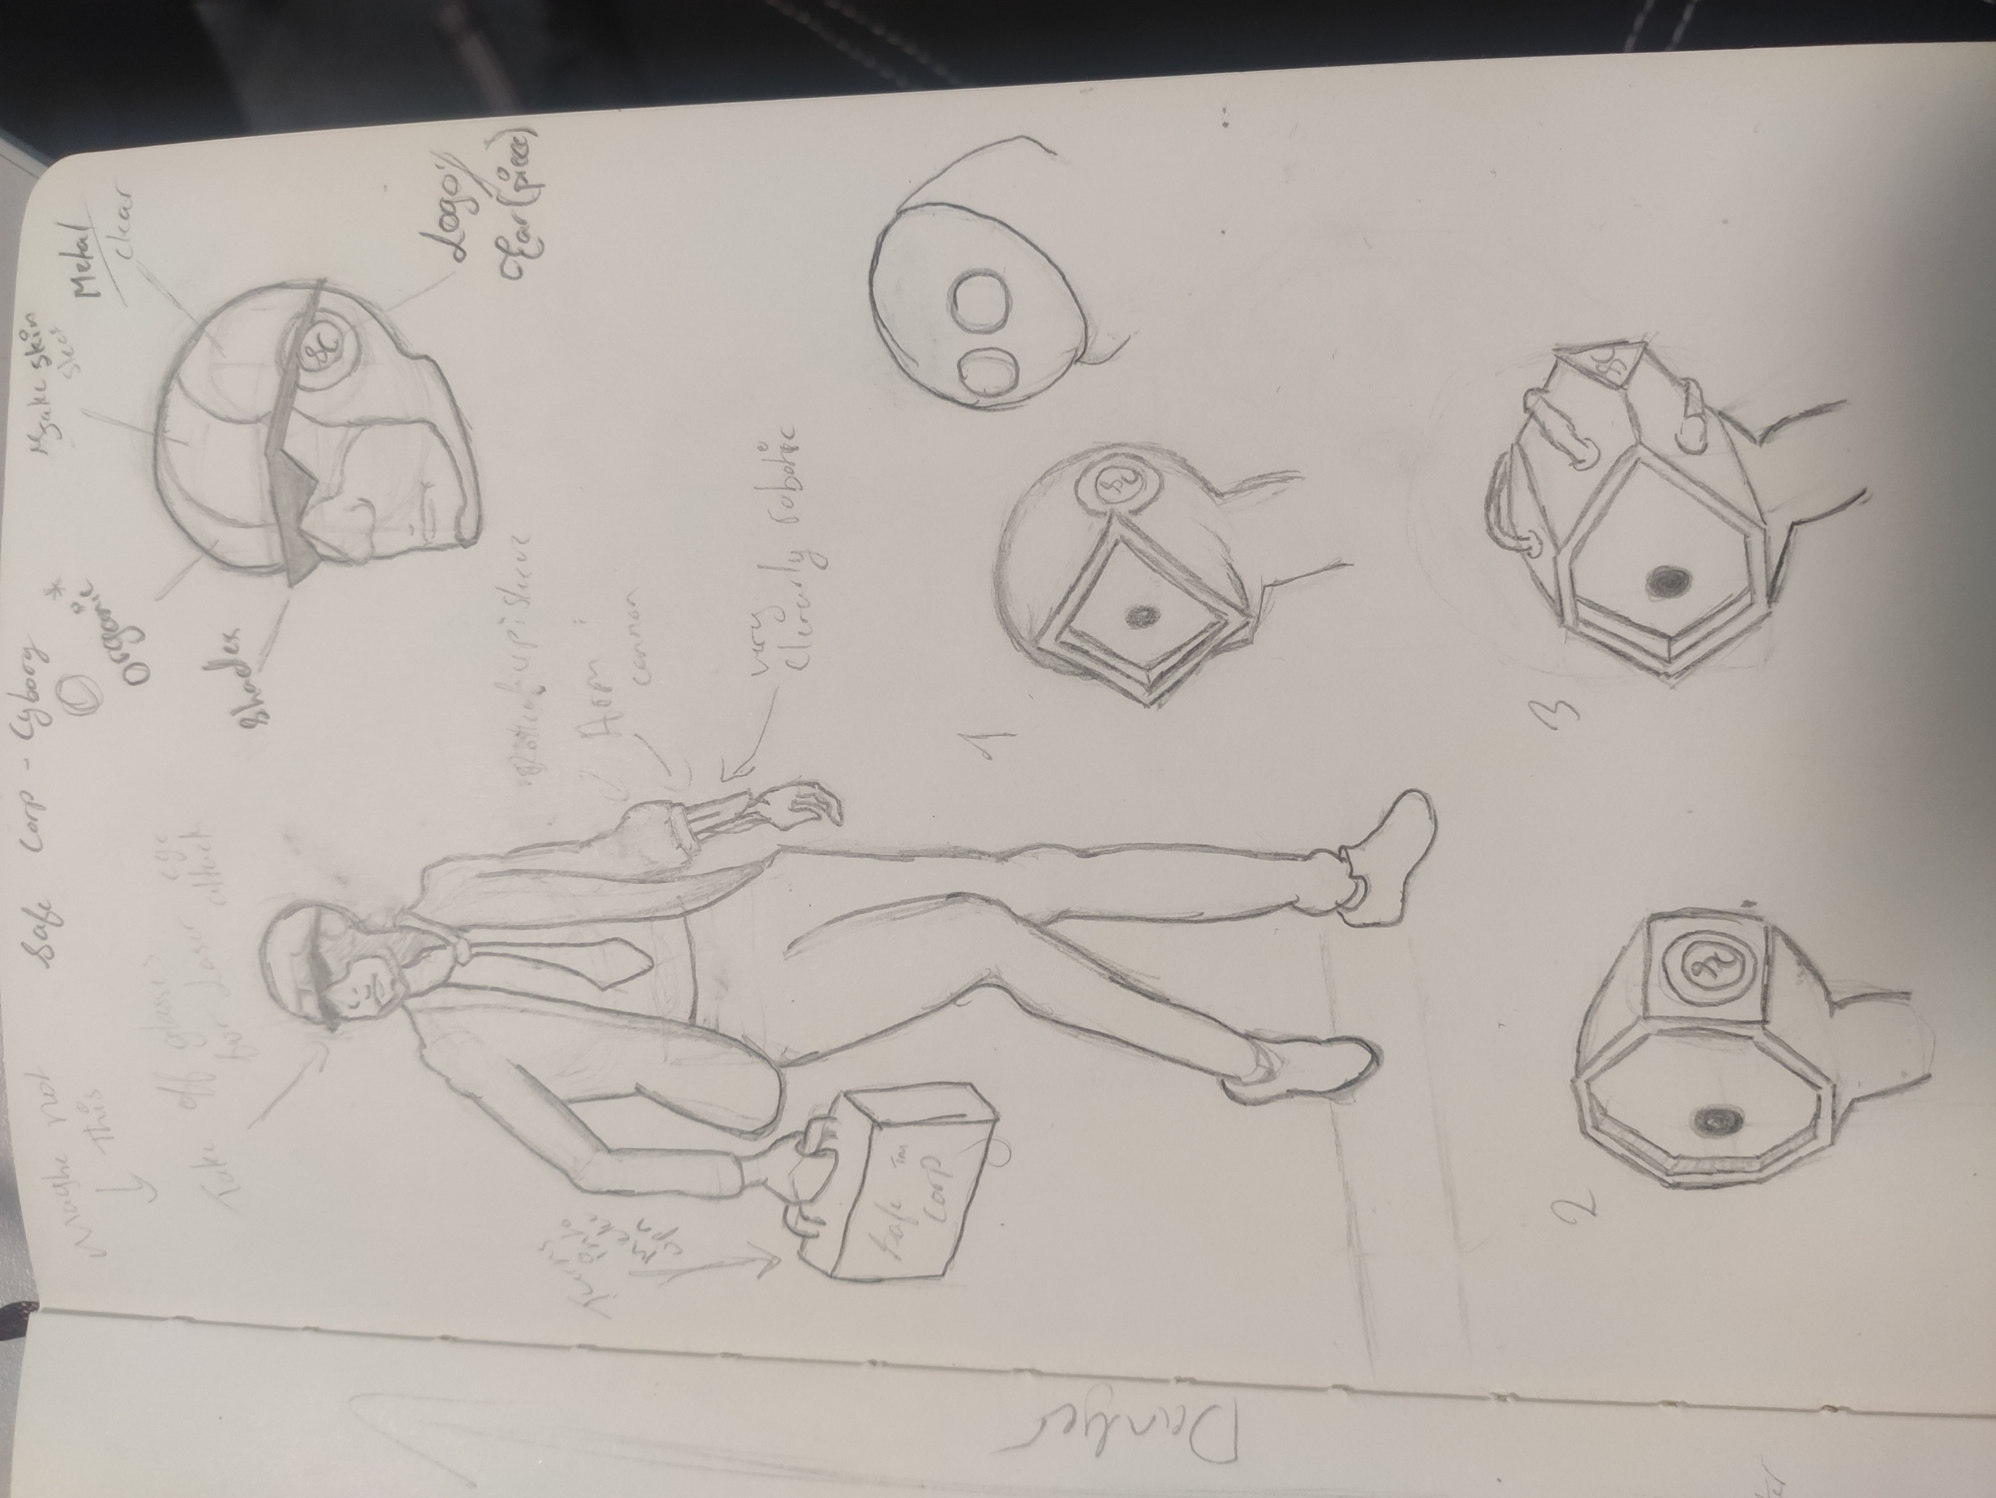
Concept Art
VIP Design Concept 1
VIP Design Concept 2
Enemy Concept 1
Player Unit Concept Design
Player Unit 3D Model

Slide 9

Fitting The Brief
Resource management, Unit management, Unit upgrades, Complex combat system.
Quality over quantity with our focus
Real time decision making not being overwhelming.
Narrative around Safe-Corp.
Realistic character proportions, but a half tones shading style

Slide 10
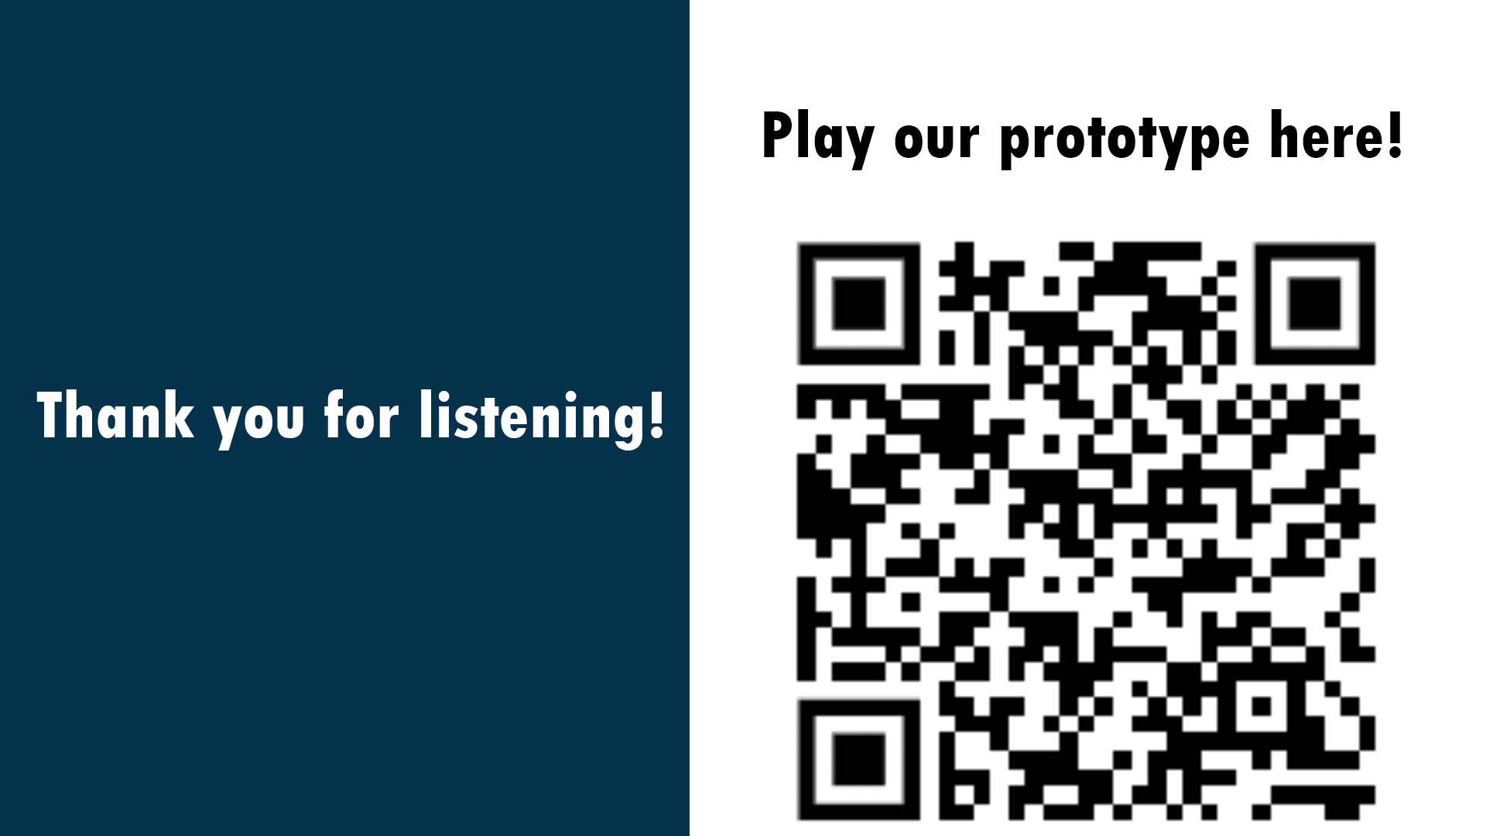
Ending Slide

